Slide 1

Genome-wide approach to identify transcripts
induced by DNA demethylation in tumor cells
Axelle Loriot
Computational Biology and Bioinformatics de Duve Institute

Slide 2
Methylation profiles are profoundly altered in cancer cells
^{5m}Cytosine
Cytosine
SOMATIC CELL
HYPOMETYLATION
HYPERMETYLATION
TUMOR CELL
GERMLINE SPECIFIC GENES
TUMOR SUPPRESSOR GENES

Slide 3
Genome-wide approach to uncover the set of transcripts
activated by DNA demethylation in tumors
Other tissue specific genes reactivated by demethylation in tumors ?
Tumor specific transcripts could be isoforms using demethylated alternative promoters
Other tissue specific genes?
TUMOR CELL
GERMLINE SPECIFIC GENES

Slide 4




METHODOLOGY
RNA-seq
fastq
Bisulfite-seq
fastq
OMICS CATALOGUE OF
LUNG ADENOCARCINOMA CELL LINES
Accession: PRJDB2256
hisat2
BisMark
26 LUAD cell lines
StringTie
de novo transcript
assembling
Transcripts activated in cell lines
showing an inverse correlation between methylation and expression
Normal tissues
Tissue specificity analysis
Methylation profile analysis

Slide 5
214 transcripts identified
Reference gene
No gene reference
128
Normal
transcripts
63
Alternative
transcripts
23
Unknown
transcripts

Slide 6
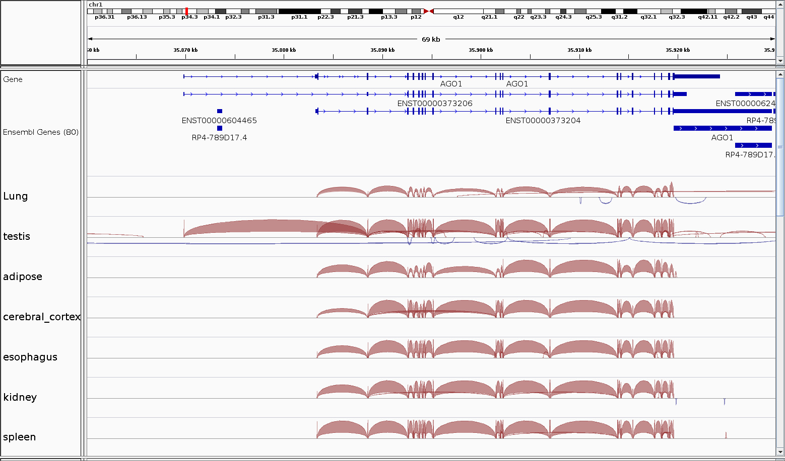
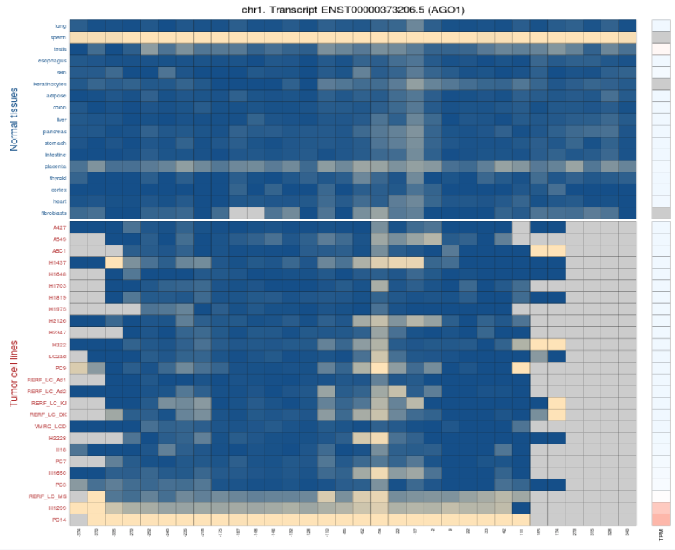
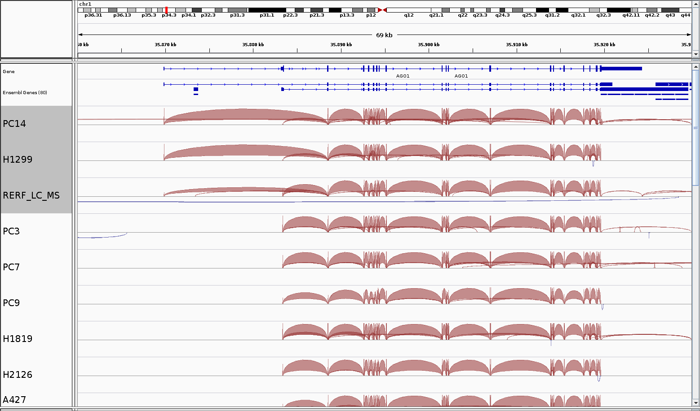
AGO1: an example of alternative transcript activated by demethylation
128
Normal
transcripts
63
Alternative
transcripts
23
Unknown
transcripts

Slide 7

Tissue specificity
RNAseq of 53 normal tissues
Multiple samples per tissues
Processed data only
=> Expression values are given at Gene level
Reference gene
128
Normal
transcripts
63
Alternative
transcripts
23
Unknown
transcripts

Slide 8
Tissue specificity
26 LUAD cell lines
50 normal tissues from Gtex

Slide 9
Tissue specificity
26 LUAD cell lines
50 normal tissues from Gtex
Lung

Slide 10
Tissue specificity
Testis specific genes
26 LUAD cell lines
50 normal tissues from Gtex
Lung
Testis

Slide 11
Tissue specificity
Testis specific genes
Gut genes
Lung
Colon (transverse)
Small intestine
Stomach
Kidney (cortex)
Kidney (medulla)
Liver
Pancreas
Testis

Slide 12
Tissue specificity
Testis specific genes
Gut genes
Stratified epithelium genes
Lung
Skin
Vagina
Esophagus (mucosa)
Testis
Squamous stratified epithelium

Slide 13

Survival analyses
Testis specific genes
Gut genes
Stratified epithelium genes
Is the activation of these genes in LUAD tumors
associated to particular clinical features ?
tumor Stage
Tumor grade
Survival

Slide 14
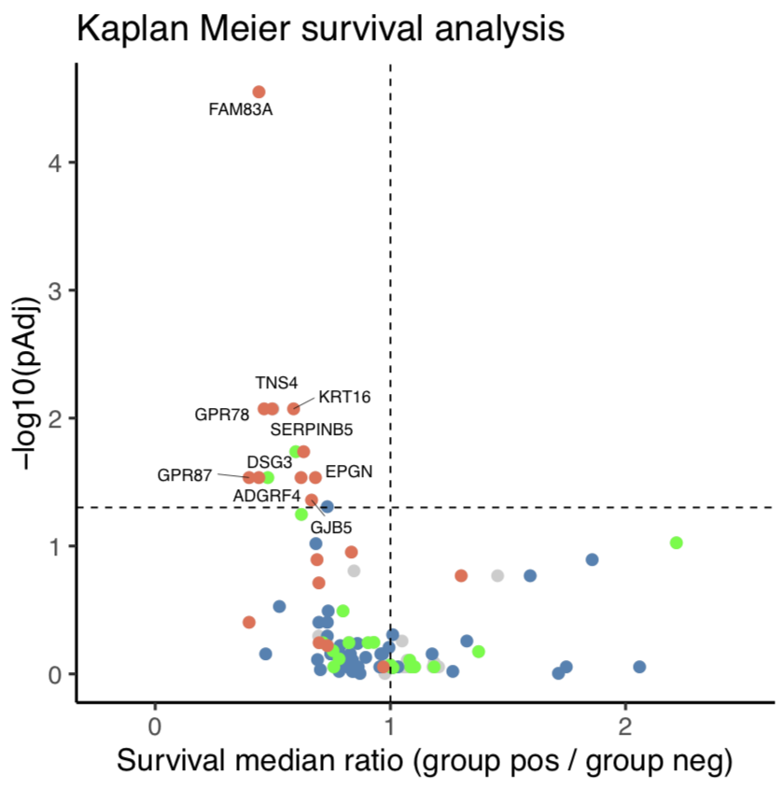
Survival analyses
Stratified
epithelium
genes
Is the activation of these genes in LUAD tumors
associated to particular clinical features ?
Bad prognosis
Goog prognosis
tumor Stage
Tumor grade
Survival

Slide 15
Survival analyses
FAM83A
TNS4
GPR87
DSG3
ADGRF4
GPR78
Bad prognosis
Goog prognosis
EPGN
KRT16
SERPINB5
GJB5

Slide 16
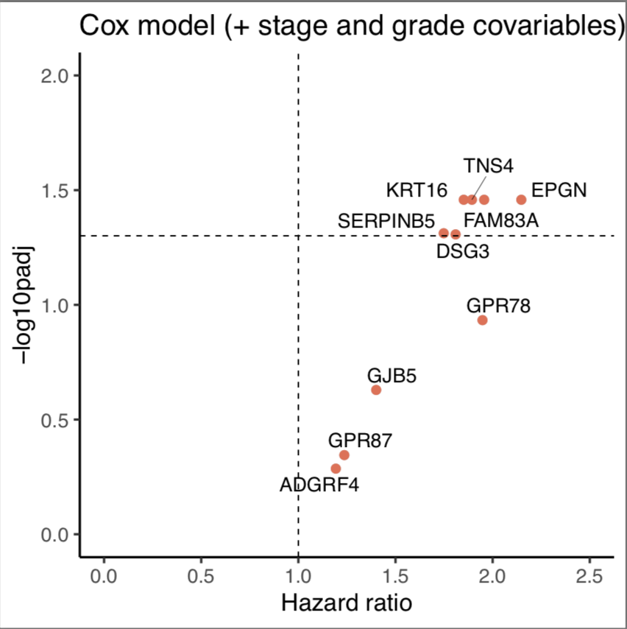
Survival analyses
FAM83A
TNS4
GPR87
DSG3
ADGRF4
GPR78
Goog prognosis
Bad prognosis
EPGN
KRT16
SERPINB5
GJB5

Slide 17
CONCLUSION
Stratified epithelium genes
Associated to bad prognosis
Prognosis biomarkers
Oncogenic functions ?

Slide 18
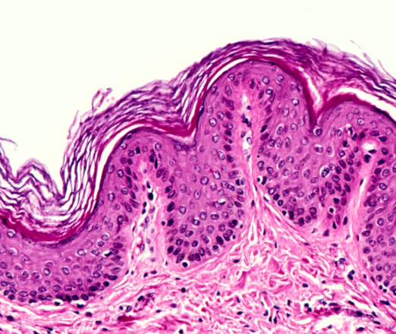
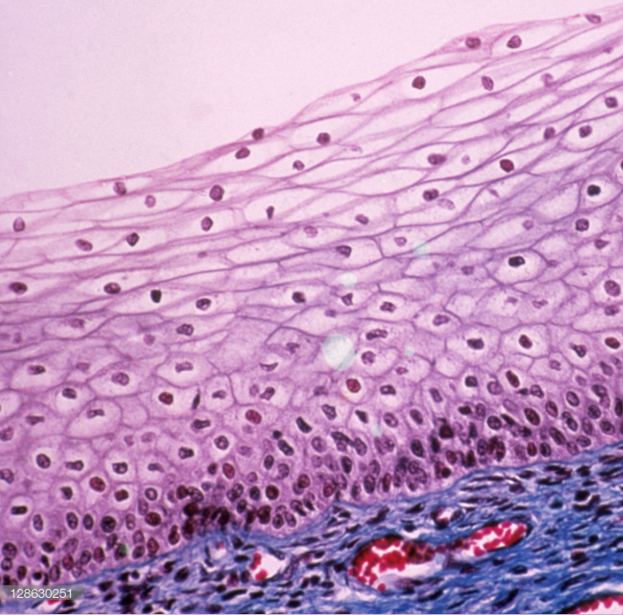
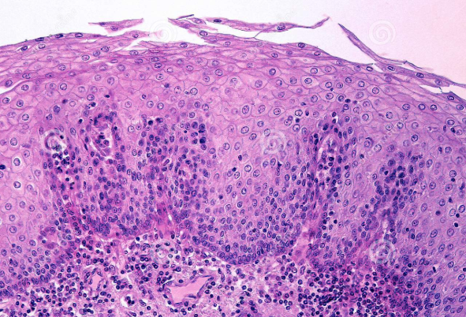
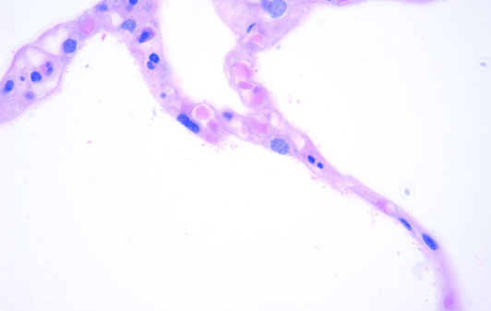
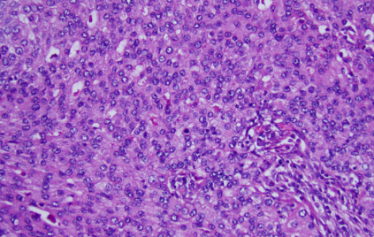
CONCLUSION
Skin epithelium
Stratified epithelium genes
Vagina epithelium
Associated to bad prognosis
Prognosis biomarkers
Oncogenic functions ?
Activation of “stratification” genes ?
Esophagus epithelium
alveoli epithelium of lung
Multilayer mass of cells
squamous stratified epithelium
LUAD

Slide 19
CONCLUSION
Stratified epithelium genes
Associated to bad prognosis
Prognosis biomarkers
Oncogenic functions ?
Activation of “stratification” genes ?
Preliminary results:
alveoli epithelium of lung
Multilayer mass of cells
Other epithelium stratified genes are also
activated in LUAD tumors by a mechanism
independent of DNA methylation
LUAD
« Stratification » gene signature in LUAD tumors ?

Slide 20


Pr Charles De Smet
Anna Diacofotakis
Genetics and Epigenetics Unit
De Duve Institute
belgium
Pr Laurent Gatto
Computational Biology and Bioinformatics de Duve Institute
Actions de Recherches concertées

